Slide 1
marmara unıversıty engıneerıng faculty department of computer scıence and engıneerıng econ 2004.1 mıdterm project ıntroductıon of Sneakıst
Prepared By: hüseyin kerem mican 150119629
Name of the Project: sneakıst

Slide 2

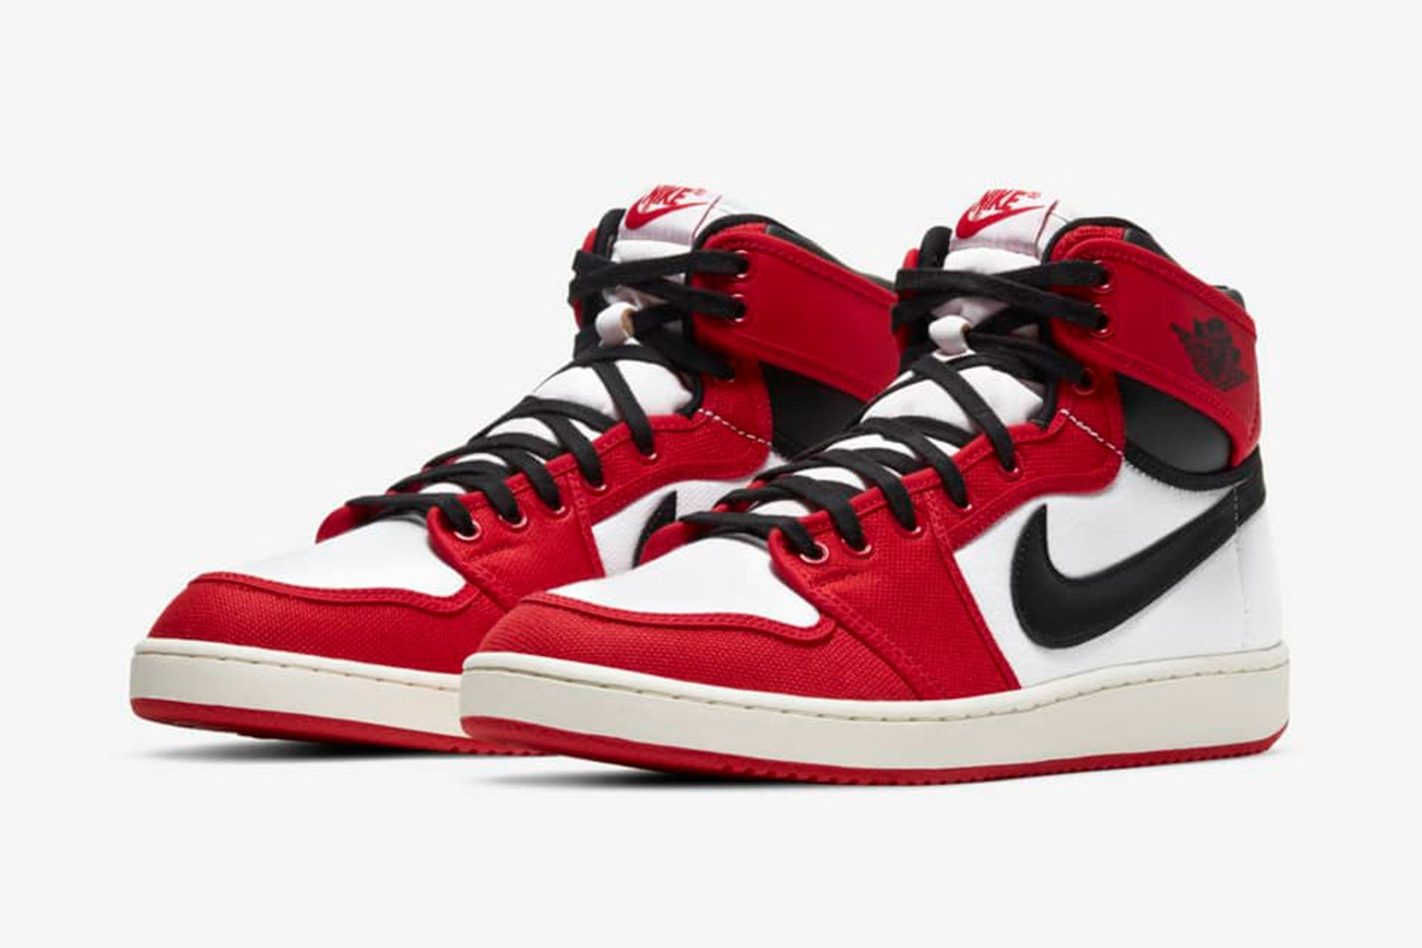
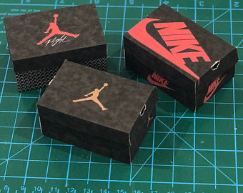
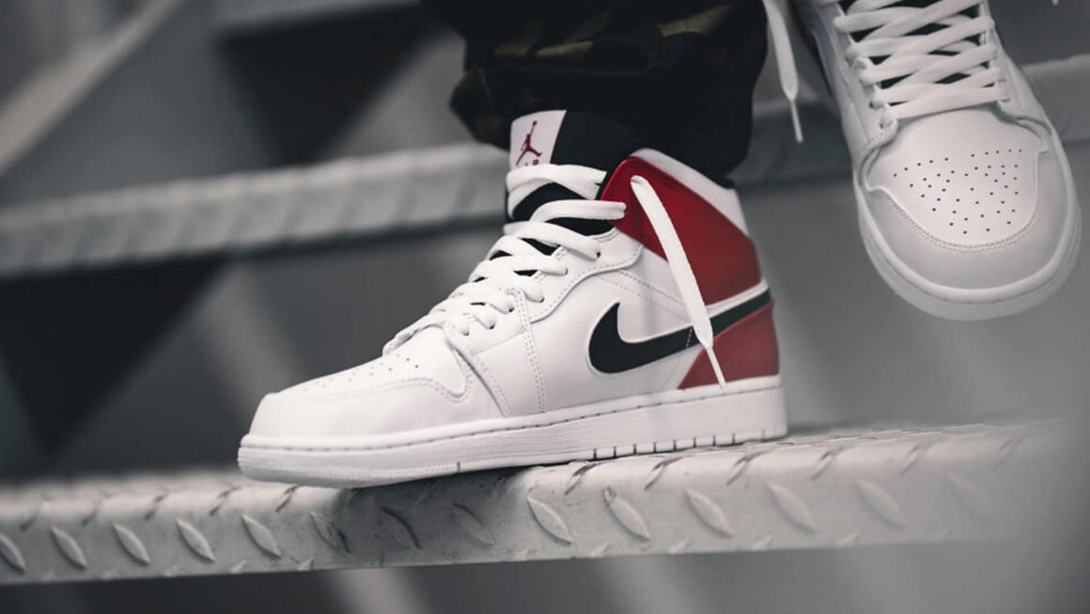
Products we wıll sell on our websıte

Slide 3
INTRODUCTION:
This service has no proper respresentative in Turkey. Our aim is to reduce prices and increase reliability. There are several companies trying to do the same thing, but they have exorbitant prices, or they are not reliable. There are such systems working properly abroad, but because of the dollar exchange rate, only some of the population can buy these products from Turkey.
The main reason these sneakers are expensive is that they are limited in number. They can be sold out the first day they come out. And they are representative of American basketball culture, which is popular around the world.
We are planning to open offices in three cities in Turkey, head office will be in Istanbul. And we will focus on Turkey first. Our process will be on our website, which will be sneakist.com. People will buy our products on this site. We will buy therese products wholesale abroad, so we will do what Nike can’t do in Turkey.
There will be 2 types of products: Unused new product and used secondhand product. Their prices will differ according to the condition. For example, if new product’s price is 200$, used product will be maximum 175$, and according to its condition it can be 150$, even 120$. This will stimulate the market.
There is one more thing that we will do is to check the products before it reaches the buyer. This is the main thing we do to become a reliable company. In our offices around Turkey, the secondhand seller will send the product to one of our nearest office and there will be a process which performed by trained people. If it passes our tests, we will send it to buyer.

Slide 4
Our website will be easy to use. We will advertise our system and introduce it to our country. Buying process will be fast and simple. Shortly, anyone who wants to buy a sneaker can buy easily. We will attach great importance to secondhand shopping. This will be better and easier in our country.
There will be discounts and shipping will be cheaper compared to other competitors. And we are planning to sell only Nike’s products, it might change in the future.
A few years after establishing the company, we want to sell other products such as t-shirts, shorts, especially sportswear. They are all will be original again. We will apply the same process.
Finally, our system will be at the forefront in our country. If things go well, we will open up abroad, but out priority will be the youth of this country. We will fulfill the requests of people who cannot reach standard products that are easy to reach abroad.
Note: There is a link if you want to compare. Shipping and prices abroad are too high. We wil bring a solution to this problem. Our people deserve better.
https://www.goat.com/sneakers/air-jordan-1-retro-high-og-shadow-2-0-555088-035/buy?boxCondition=good_condition&size=9.5
(This one is an example product. We aim to sell these kind of sportswear.)

Slide 5
Swot analysıs:
STRENGHTS: We will have lower prices. People will be able to shop secondhand. We care about our customers, and we will have an excellent customer support. We will hire trained people. Our main products will be reachable all around the country. Also, we will have physical offices, we won’t only work on the internet. | WEAKNESSES: There are some companies which has some reputation, so there will be a competition. We will get some of the new products from Europe countries, they might be expensive. We will need supportive investors.
OPPORTUNITIES: Popular and expensive products can be bought by any kind of person, everyone will know and want these products. They will be popular in our country too. We will compete with other companies, and we will be a better company because we care about our customers. We will spread this new culture, so our country won’t be left behind. | THREATS: If Turkey’s economy collapses, we would go bankrupt too. Because our products come Turkey from other countries. Also exchange rate is important for us. If the product taxes increase, it will be bad for us. So, all threats are about our country.

